Slide 1



Sales Insights - Data Analysis Project using Tableau & SQL
By :- Ashish Kumar Singh
https://public.tableau.com/app/profile/ashish.kumar.singh2884/vizzes
https://github.com/AshishKumarSingh03
https://www.linkedin.com/in/ashish-kumar-singh-88235a186/

Slide 2
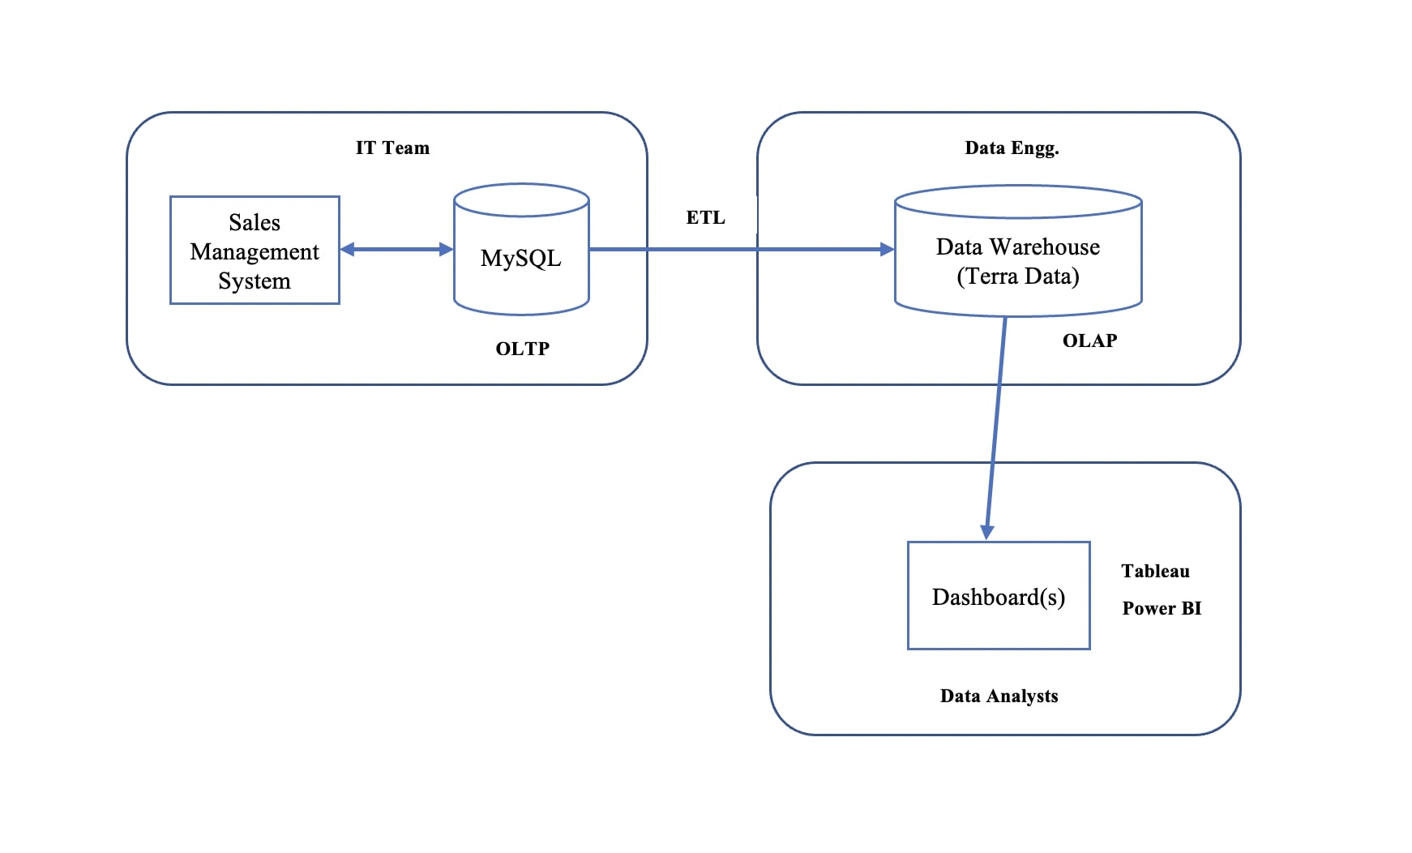

Slide 3
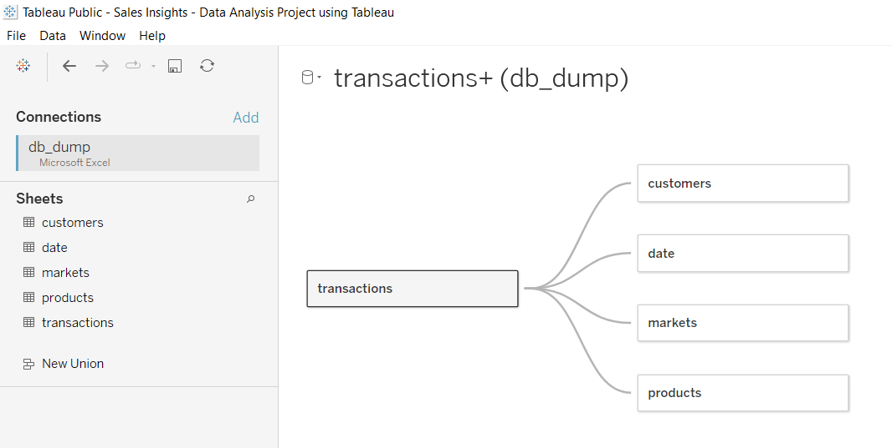

Slide 4
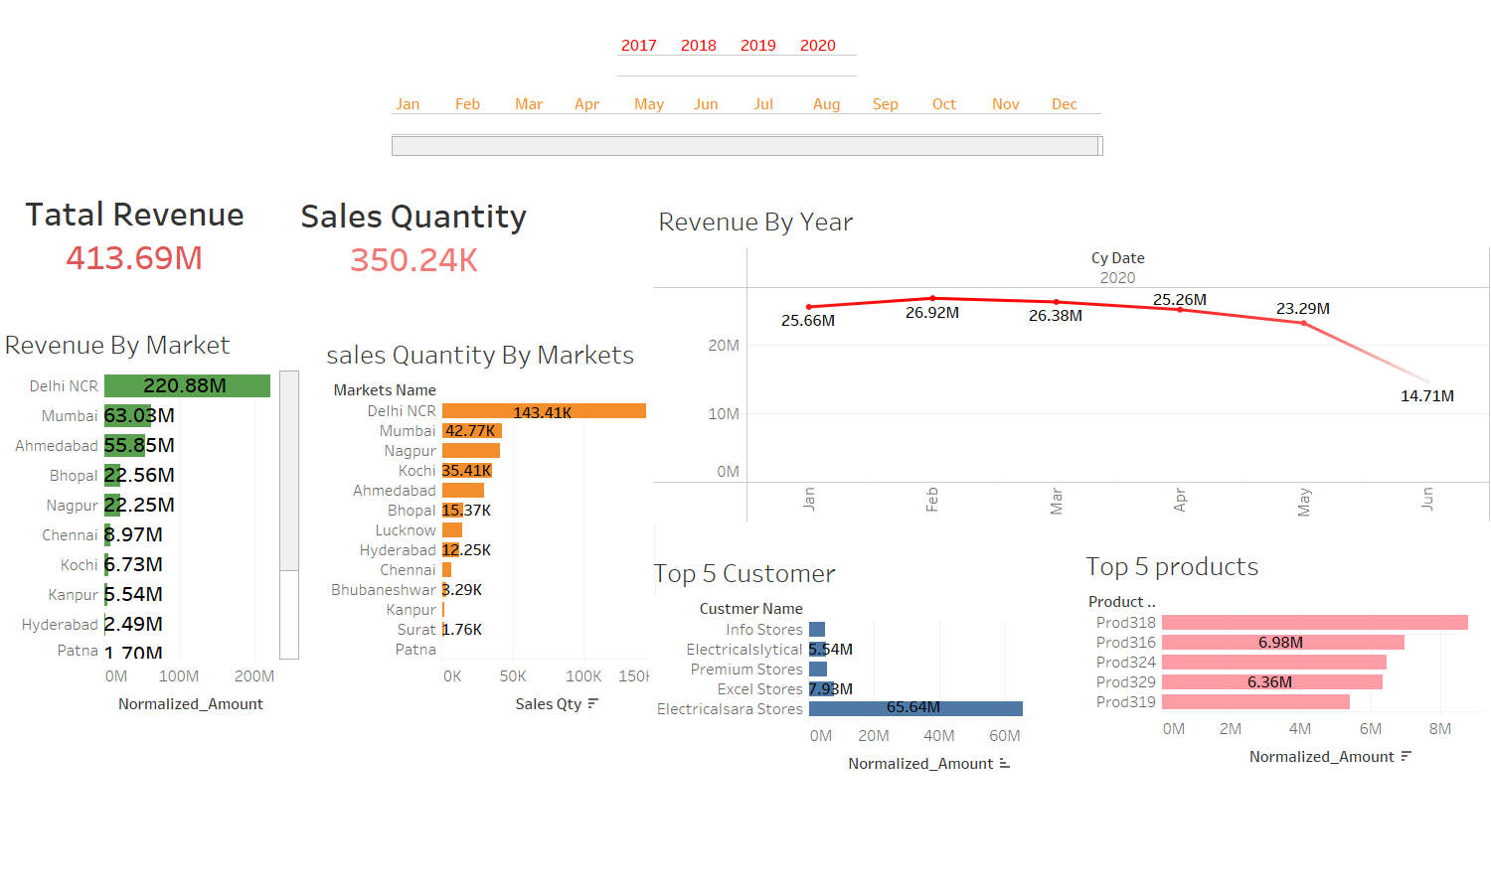

Slide 5
